Slide 1
Reinforcement Learning
Lecture 1
Lawrence Carin
Duke University

Slide 2



Slide 3
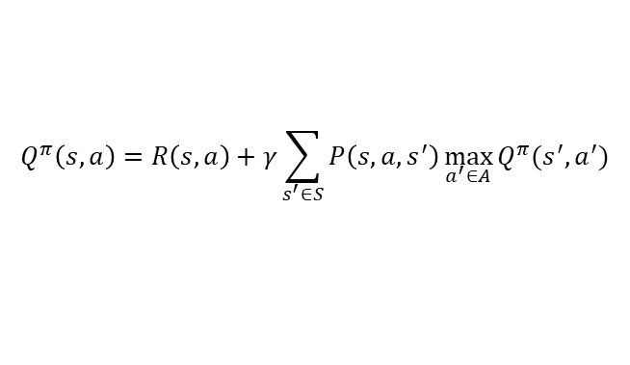
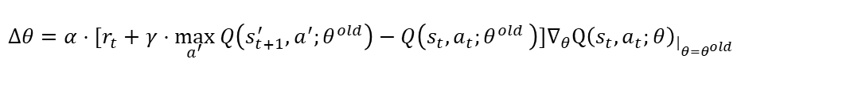
$$Q^{π}\left(s,a\right)=R\left(s,a\right)+γ\sum_{s^{′}∈S}{P\left(s,a,s^{′}\right)\max_{a^{′}∈A}{Q^{π}(s^{′},a^{′})}}$$
${Q(s_{t},a_{t};θ}^{new})=Q(s_{t},a_{t};θ^{old}+α⋅[r_{t}+γ⋅\max_{a^{′}} Q\left(s_{t+1}^{′},a^{′};θ^{old}\right)−Q\left(s_{t},a_{t}{;θ}^{old}\right)]∇_{θ}Q{\left(s_{t},a_{t};θ\right)}_{{\left.​\right|}_{θ=θ^{old}}}$)
$Δθ=α⋅[r_{t}+γ⋅\max_{a^{′}} Q\left(s_{t+1}^{′},a^{′};θ^{old}\right)−Q\left(s_{t},a_{t}{;θ}^{old}\right)]∇_{θ}Q{\left(s_{t},a_{t};θ\right)}_{{\left.​\right|}_{θ=θ^{old}}}$
$${Q(s_{t},a_{t};θ}^{old}+Δθ)≈Q\left(s_{t},a_{t};θ^{old}\right)+α⋅\left[r_{t}+γ⋅\max_{a^{′}} Q\left(s_{t+1}^{′},a^{′};θ^{old}\right)−Q\left(s_{t},a_{t}{;θ}^{old}\right)\right]||∇_{θ}Q{\left(s_{t},a_{t};θ\right)}_{{\left.​\right|}_{θ=θ^{old}}}||_{2}^{2}$$

Slide 4
$$Q^{π}\left(s,a\right)=R\left(s,a\right)+γ\sum_{s^{′}∈S}{P\left(s,a,s^{′}\right)\max_{a^{′}∈A}{Q^{π}(s^{′},a^{′})}}$$
MATHEMATICS!!
${Q(s_{t},a_{t};θ}^{new})=Q(s_{t},a_{t};θ^{old}+α⋅[r_{t}+γ⋅\max_{a^{′}} Q\left(s_{t+1}^{′},a^{′};θ^{old}\right)−Q\left(s_{t},a_{t}{;θ}^{old}\right)]∇_{θ}Q{\left(s_{t},a_{t};θ\right)}_{{\left.​\right|}_{θ=θ^{old}}}$)
$Δθ=α⋅[r_{t}+γ⋅\max_{a^{′}} Q\left(s_{t+1}^{′},a^{′};θ^{old}\right)−Q\left(s_{t},a_{t}{;θ}^{old}\right)]∇_{θ}Q{\left(s_{t},a_{t};θ\right)}_{{\left.​\right|}_{θ=θ^{old}}}$
$${Q(s_{t},a_{t};θ}^{old}+Δθ)≈Q\left(s_{t},a_{t};θ^{old}\right)+α⋅\left[r_{t}+γ⋅\max_{a^{′}} Q\left(s_{t+1}^{′},a^{′};θ^{old}\right)−Q\left(s_{t},a_{t}{;θ}^{old}\right)\right]||∇_{θ}Q{\left(s_{t},a_{t};θ\right)}_{{\left.​\right|}_{θ=θ^{old}}}||_{2}^{2}$$

Slide 5

Consider an MD, seeking to treat patients in an
effective manner, while minimizing costs
The state of health for each patient is observed in terms of a set of clinical variables

Slide 6
Consider an MD, seeking to treat patients in an
effective manner, while minimizing costs
The state of health for each patient is observed in terms of a set of clinical variables
Assume there are a set of actions the MD can perform
Each action will impact the health state of the patient (possibly no change in the state)

Slide 7
Consider an MD, seeking to treat patients in an
effective manner, while minimizing costs
The state of health for each patient is observed in terms of a set of clinical variables
Assume there are a set of actions the MD can perform
Each action will impact the health state of the patient (possibly no change in the state)
Seek a policy that achieves the best outcomes at the lowest average price
Could apply to particular types of patients (e.g., diabetics) or in particular settings within a health system (e.g., operating room)

Slide 8
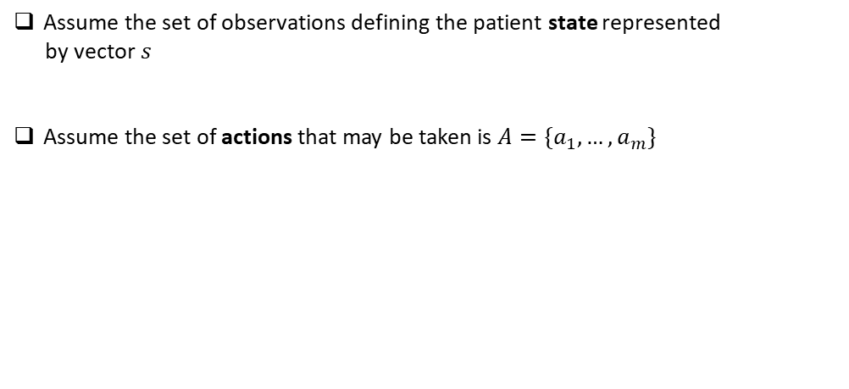
Assume the set of observations defining the patient state represented
by vector $s$
Assume the set of actions that may be taken is $A=\{a_{1},…,a_{m}\}$

Slide 9
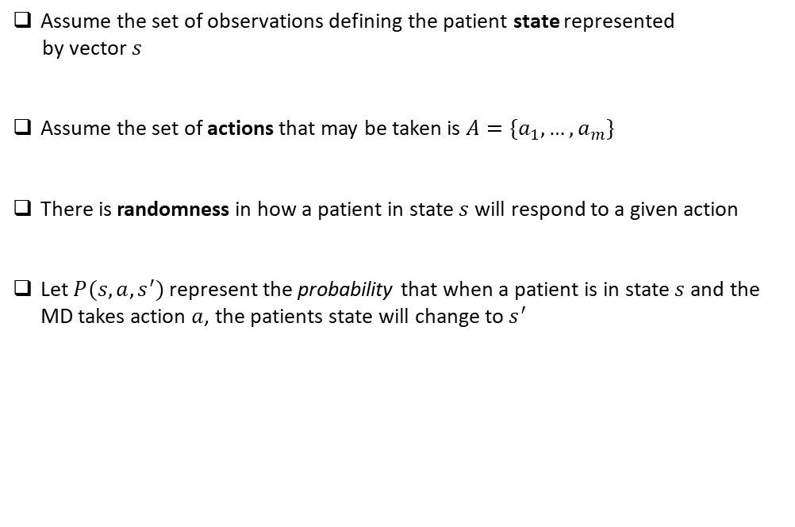
Assume the set of observations defining the patient state represented
by vector $s$
Assume the set of actions that may be taken is $A=\{a_{1},…,a_{m}\}$
There is randomness in how a patient in state $s$will respond to a given action
Let $P(s,a,s^{′})$ represent the probability that when a patient is in state $s$ and the MD takes action $a$, the patients state will change to $s^{′}$

Slide 10
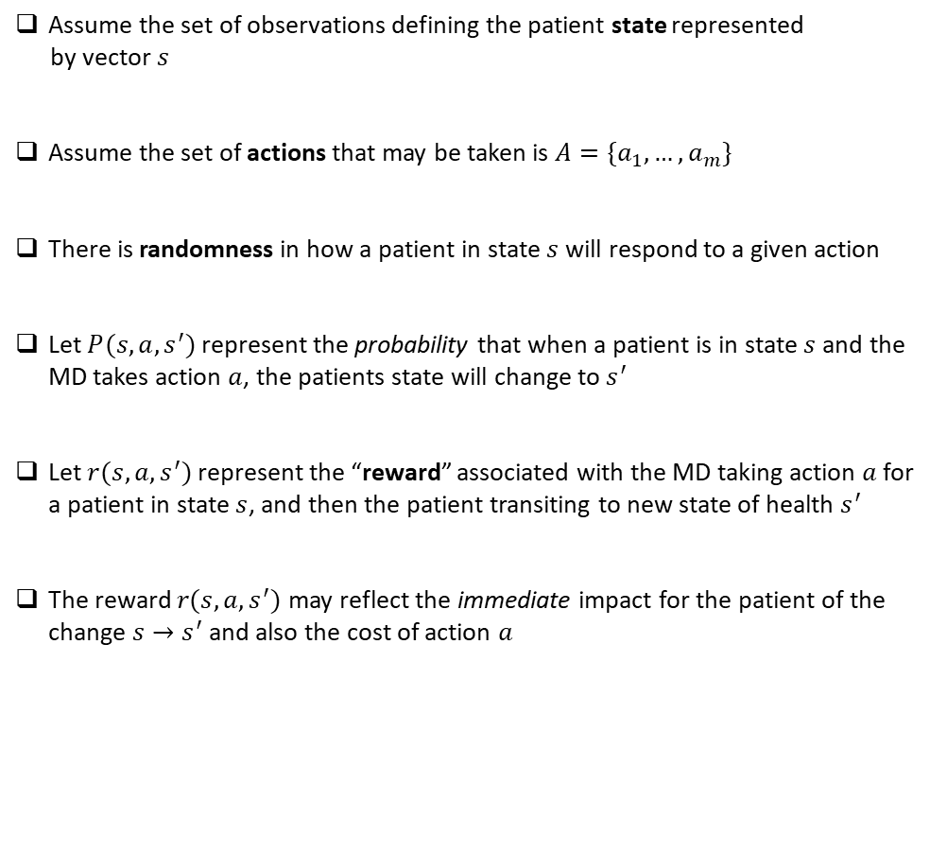
Assume the set of observations defining the patient state represented
by vector $s$
Assume the set of actions that may be taken is $A=\{a_{1},…,a_{m}\}$
There is randomness in how a patient in state $s$will respond to a given action
Let $P(s,a,s^{′})$ represent the probability that when a patient is in state $s$ and the MD takes action $a$, the patients state will change to $s^{′}$
Let $r(s,a,s^{′})$ represent the “reward” associated with the MD taking action $a$ for a patient in state $s$, and then the patient transiting to new state of health $s^{′}$
The reward $r(s,a,s^{′})$ may reflect the immediate impact for the patient of the change $s→s^{′}$ and also the cost of action $a$

Slide 11
The MD interacts with the patient through a series of actions, patient state changes, and rewards/costs
$… s_{t−1} a_{t−1} r_{t−1} { s}_{t} a_{t} r_{t} { s}_{t+1} …$

Slide 12
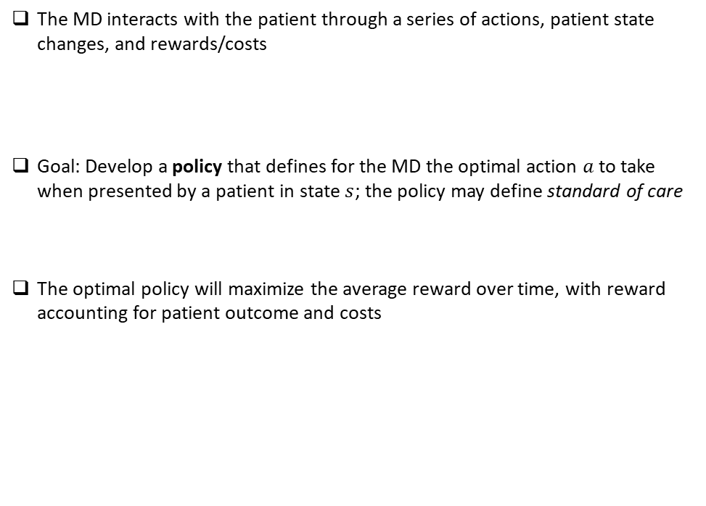
The MD interacts with the patient through a series of actions, patient state changes, and rewards/costs
Goal: Develop a policy that defines for the MD the optimal action $a$ to take when presented by a patient in state $s$; the policy may define standard of care
The optimal policy will maximize the average reward over time, with reward accounting for patient outcome and costs
$… s_{t−1} a_{t−1} r_{t−1} { s}_{t} a_{t} r_{t} { s}_{t+1} …$

Slide 13
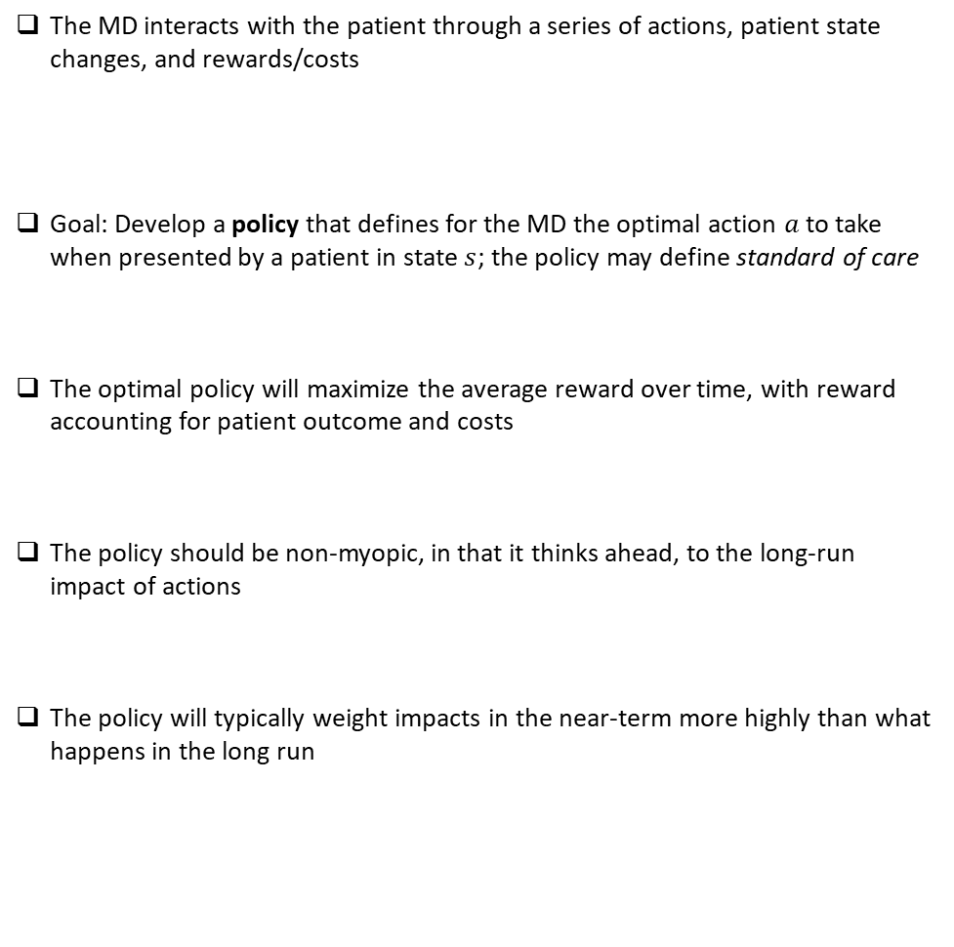
The MD interacts with the patient through a series of actions, patient state changes, and rewards/costs
Goal: Develop a policy that defines for the MD the optimal action $a$ to take when presented by a patient in state $s$; the policy may define standard of care
The optimal policy will maximize the average reward over time, with reward accounting for patient outcome and costs
The policy should be non-myopic, in that it thinks ahead, to the long-run impact of actions
The policy will typically weight impacts in the near-term more highly than what happens in the long run
$… s_{t−1} a_{t−1} r_{t−1} { s}_{t} a_{t} r_{t} { s}_{t+1} …$

Slide 14
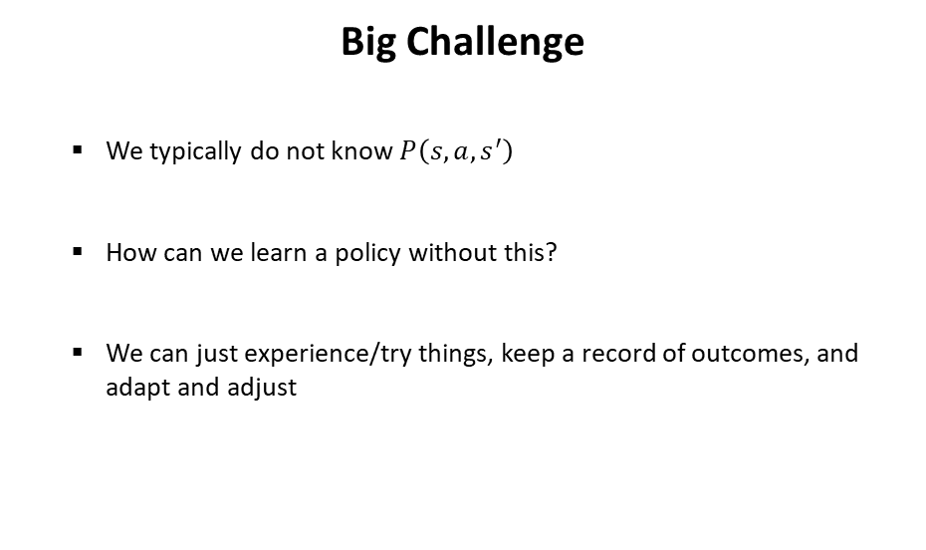
Big Challenge
We typically do not know $P\left(s,a,s^{′}\right)$
How can we learn a policy without this?
We can just experience/try things, keep a record of outcomes, and adapt and adjust

Slide 15
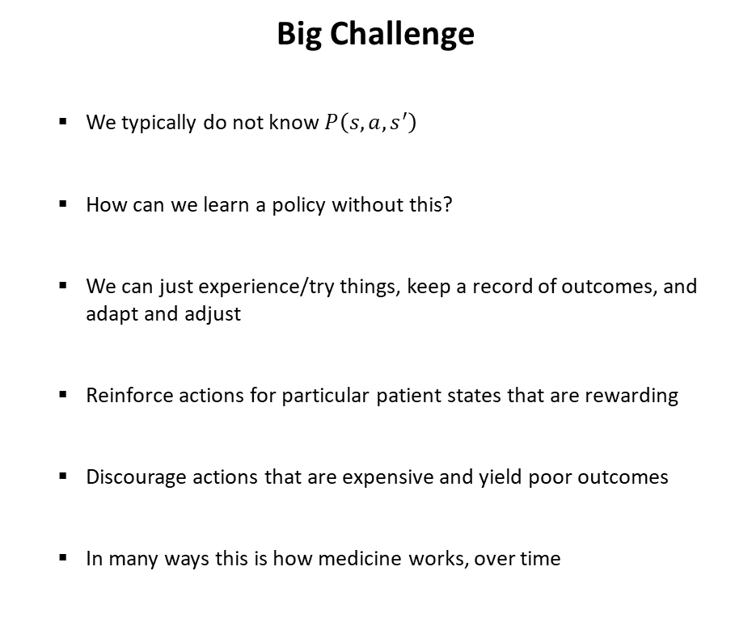
Big Challenge
We typically do not know $P\left(s,a,s^{′}\right)$
How can we learn a policy without this?
We can just experience/try things, keep a record of outcomes, and adapt and adjust
Reinforce actions for particular patient states that are rewarding
Discourage actions that are expensive and yield poor outcomes
In many ways this is how medicine works, over time

Slide 16
Reinforcement learning is the formalization of this challenge
Addresses sequential decision making in an uncertain (stochastic) world
Medicine/Health

Slide 17

Reinforcement learning is the formalization of this challenge
Addresses sequential decision making in an uncertain (stochastic) world
Monitoring/Maintenance of Factory
Medicine/Health

Slide 18

Reinforcement learning is the formalization of this challenge
Addresses sequential decision making in an uncertain (stochastic) world
Monitoring/Maintenance of Factory
Medicine/Health
Investing

Slide 19
Reinforcement learning is the formalization of this challenge
Addresses sequential decision making in an uncertain (stochastic) world
Monitoring/Maintenance of Factory
Medicine/Health
Investing

Slide 20
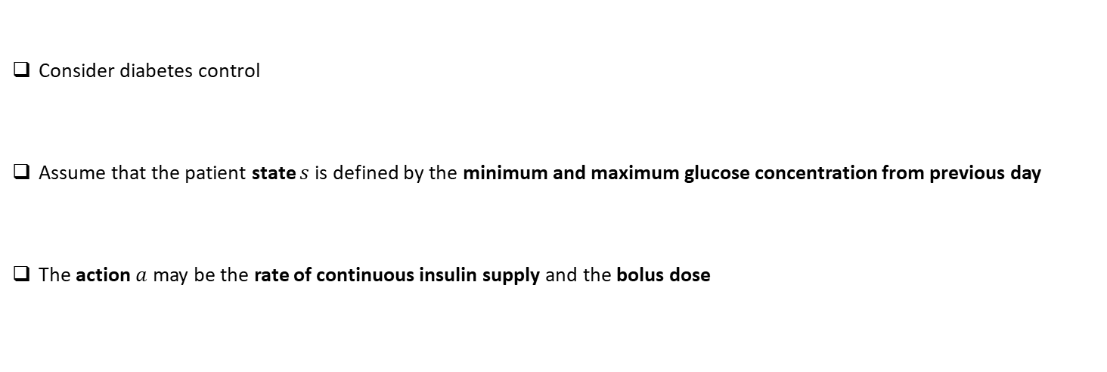
Illustrative Example
Consider diabetes control
Assume that the patient state $s$is defined by the minimum and maximum glucose concentration from previous day
The action $a$may be the rate of continuous insulin supply and the bolus dose

Slide 21
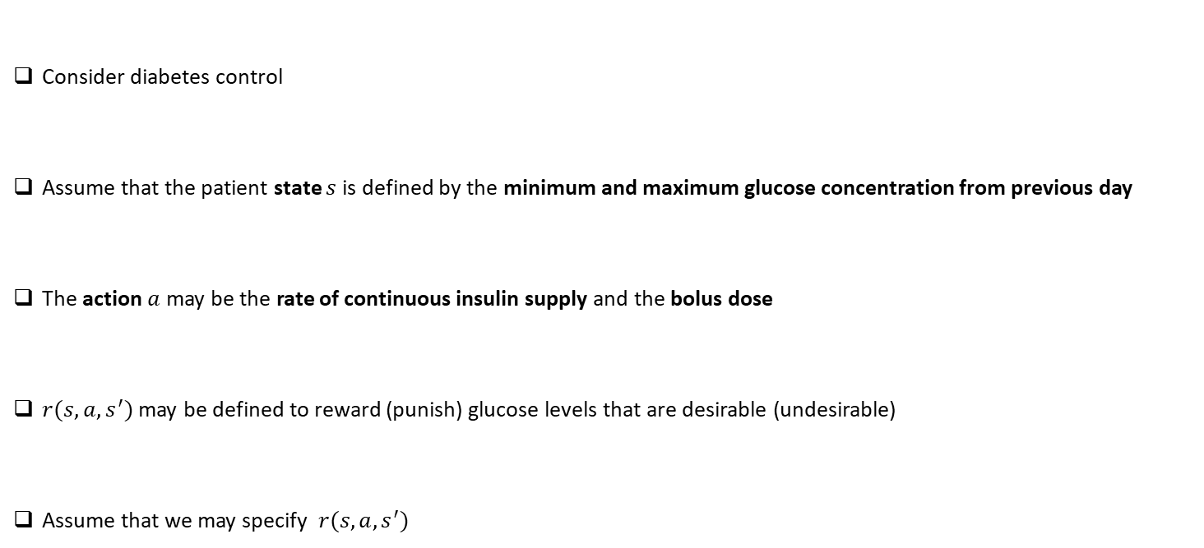
Illustrative Example
Consider diabetes control
Assume that the patient state $s$is defined by the minimum and maximum glucose concentration from previous day
The action $a$may be the rate of continuous insulin supply and the bolus dose
$r(s,a,s^{′})$ may be defined to reward (punish) glucose levels that are desirable (undesirable)
Assume that we may specify $r(s,a,s^{′})$

Slide 22
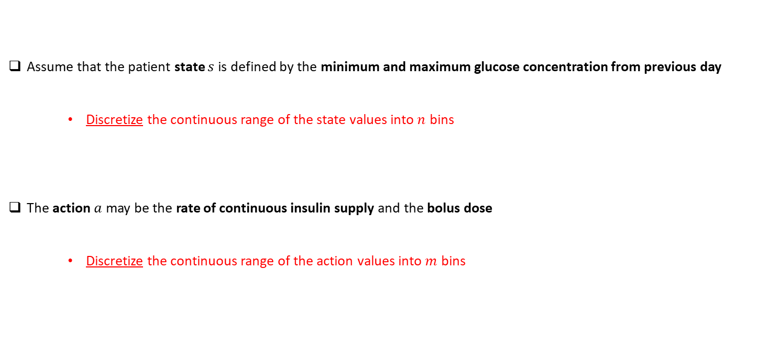
Solution Setup
Assume that the patient state $s$is defined by the minimum and maximum glucose concentration from previous day
Discretize the continuous range of the state values into $n$ bins
The action $a$may be the rate of continuous insulin supply and the bolus dose
Discretize the continuous range of the action values into $m$ bins

Slide 23
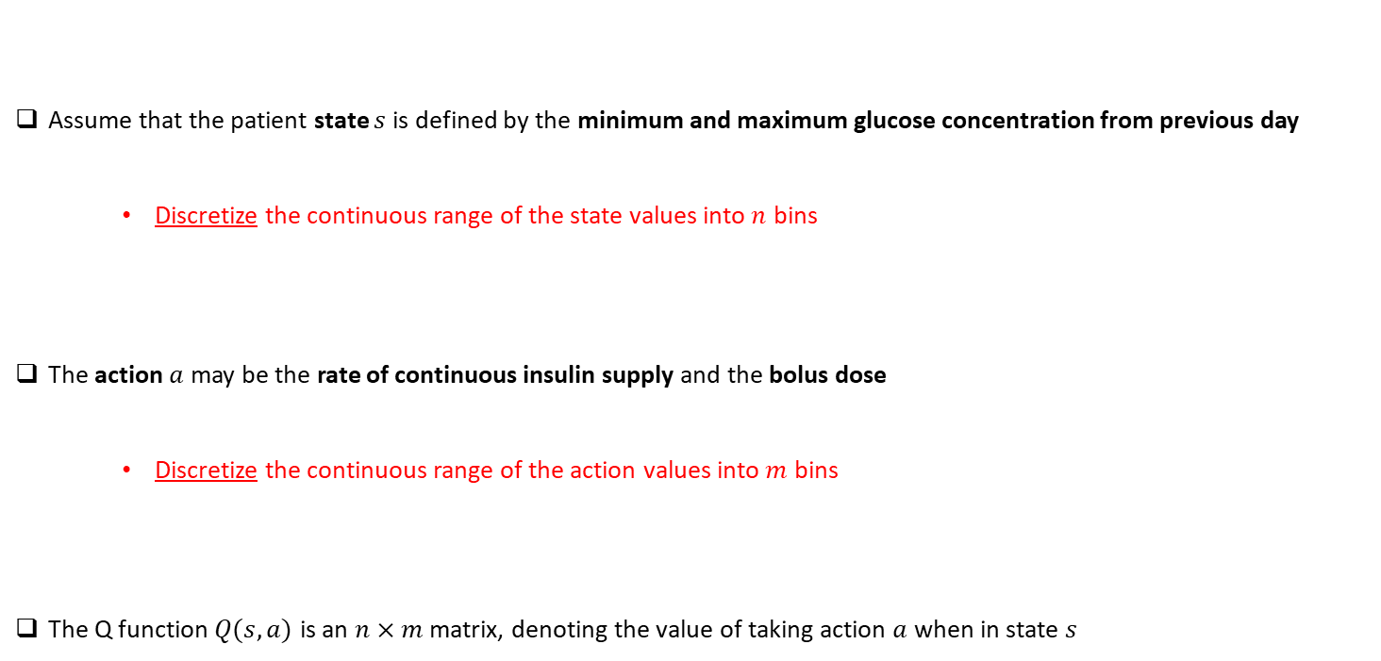
Solution Setup
Assume that the patient state $s$is defined by the minimum and maximum glucose concentration from previous day
Discretize the continuous range of the state values into $n$ bins
The action $a$may be the rate of continuous insulin supply and the bolus dose
Discretize the continuous range of the action values into $m$ bins
The Q function $Q(s,a)$ is an $n×m$ matrix, denoting the value of taking action $a$ when in state $s$

Slide 24
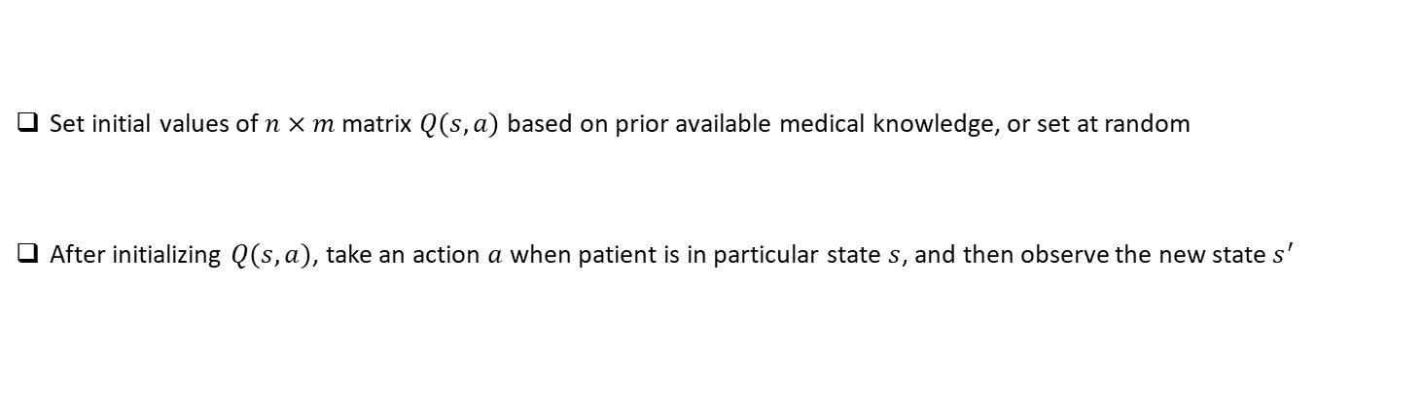
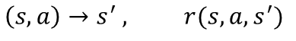
Simple, Intuitive Solution
Set initial values of $n×m$ matrix $Q(s,a)$ based on prior available medical knowledge, or set at random
After initializing $Q(s,a)$, take an action $a$ when patient is in particular state $s$, and then observe the new state $s^{′}$
$$\left(s,a\right)→s^{′} , r(s,a,s^{′})$$

Slide 25
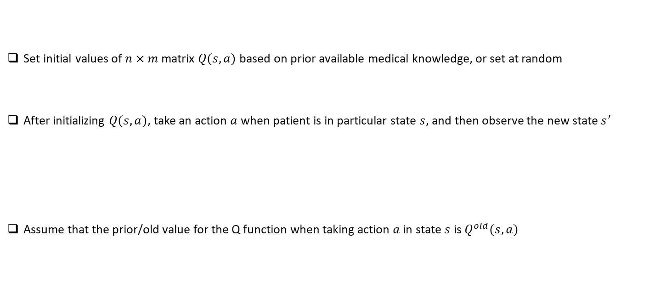
Simple, Intuitive Solution
Set initial values of $n×m$ matrix $Q(s,a)$ based on prior available medical knowledge, or set at random
After initializing $Q(s,a)$, take an action $a$ when patient is in particular state $s$, and then observe the new state $s^{′}$
Assume that the prior/old value for the Q function when taking action $a$ in state $s$ is $Q^{old}(s,a)$
$$\left(s,a\right)→s^{′} , r(s,a,s^{′})$$

Slide 26
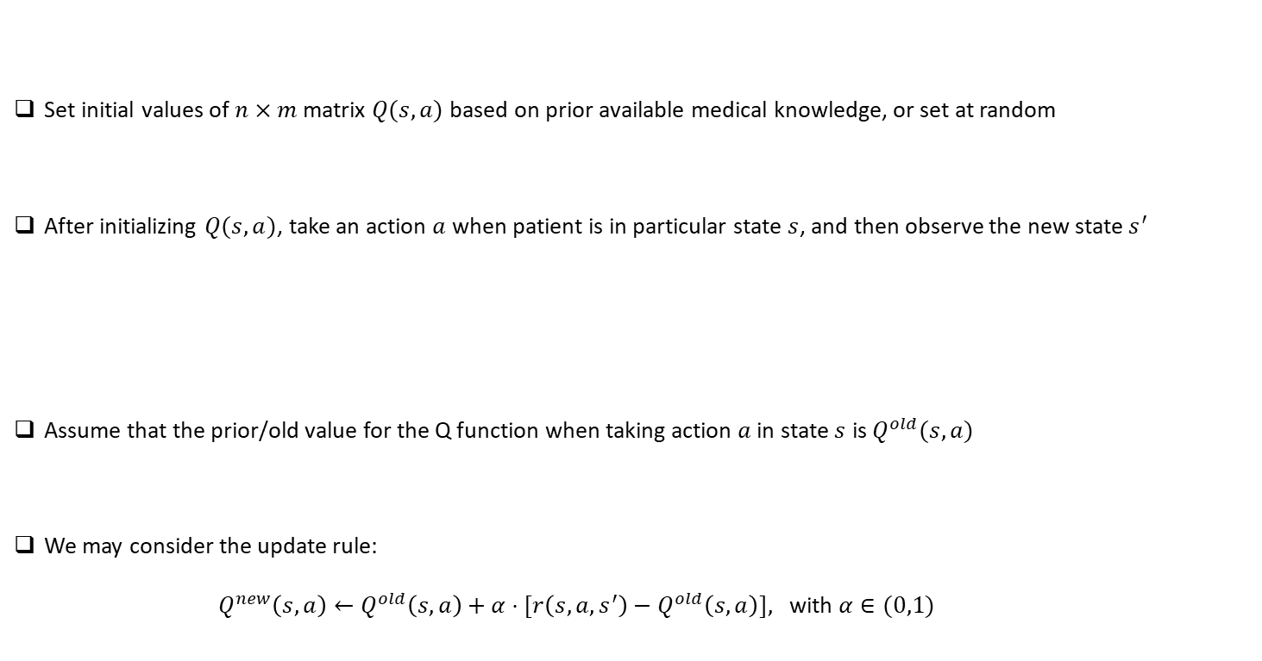
Simple, Intuitive Solution
Set initial values of $n×m$ matrix $Q(s,a)$ based on prior available medical knowledge, or set at random
After initializing $Q(s,a)$, take an action $a$ when patient is in particular state $s$, and then observe the new state $s^{′}$
Assume that the prior/old value for the Q function when taking action $a$ in state $s$ is $Q^{old}(s,a)$
We may consider the update rule:
$Q^{new}\left(s,a\right)←Q^{old}\left(s,a\right)+α⋅[r\left(s,a,s^{′}\right)−Q^{old}\left(s,a\right)],$ with $α∈(0,1)$
$$\left(s,a\right)→s^{′} , r(s,a,s^{′})$$

Slide 27
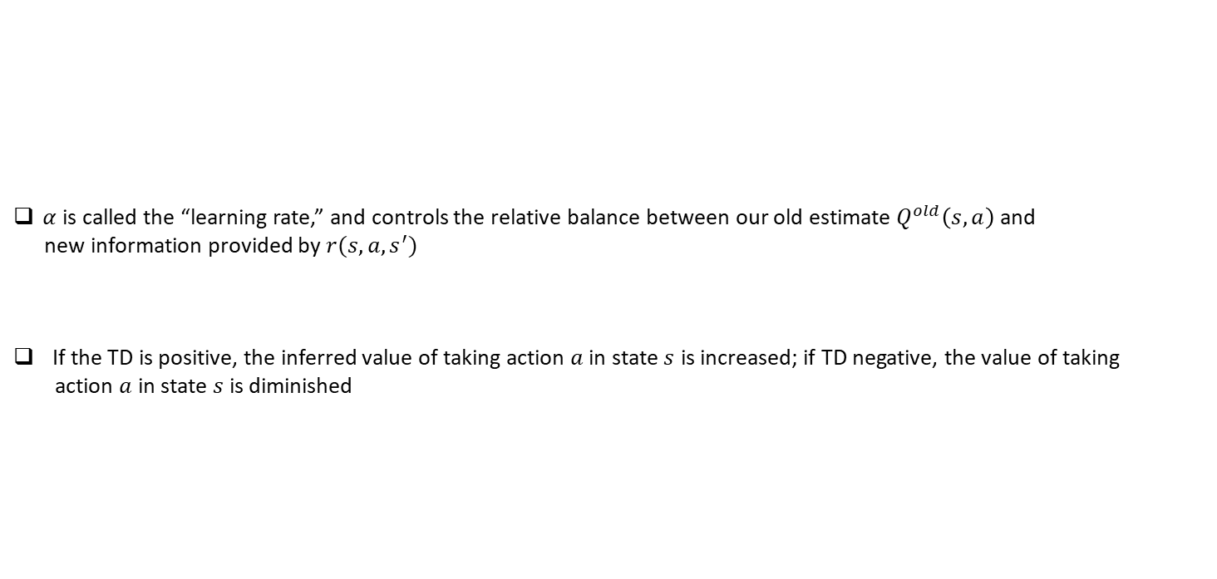
Simple, Intuitive Solution
$Q^{new}\left(s,a\right)←Q^{old}\left(s,a\right)+α⋅[ r\left(s,a,s^{′}\right)−Q^{old}\left(s,a\right)],$ with $α∈(0,1)$
$α$ is called the “learning rate,” and controls the relative balance between our old estimate $Q^{old}\left(s,a\right)$ and
new information provided by $r(s,a,s^{′})$
If the TD is positive, the inferred value of taking action $a$ in state $s$ is increased; if TD negative, the value of taking
action $a$ in state $s$ is diminished
Temporal Difference (TD)

Slide 28
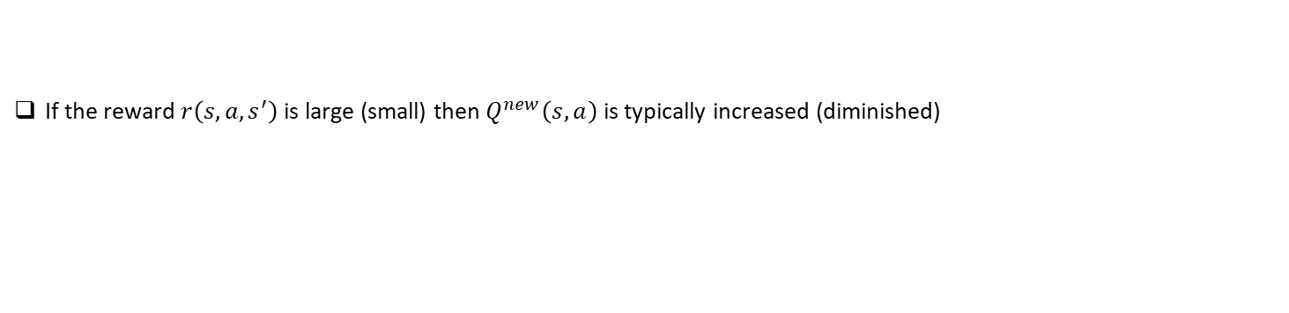
Simple, Intuitive Solution
$Q^{new}\left(s,a\right)←Q^{old}\left(s,a\right)+α⋅\left[ r\left(s,a,s^{′}\right)−Q^{old}\left(s,a\right)\right] ,$ with $α∈(0,1)$
If the reward $r\left(s,a,s^{′}\right)$ is large (small) then $Q^{new}\left(s,a\right)$ is typically increased (diminished)

Slide 29
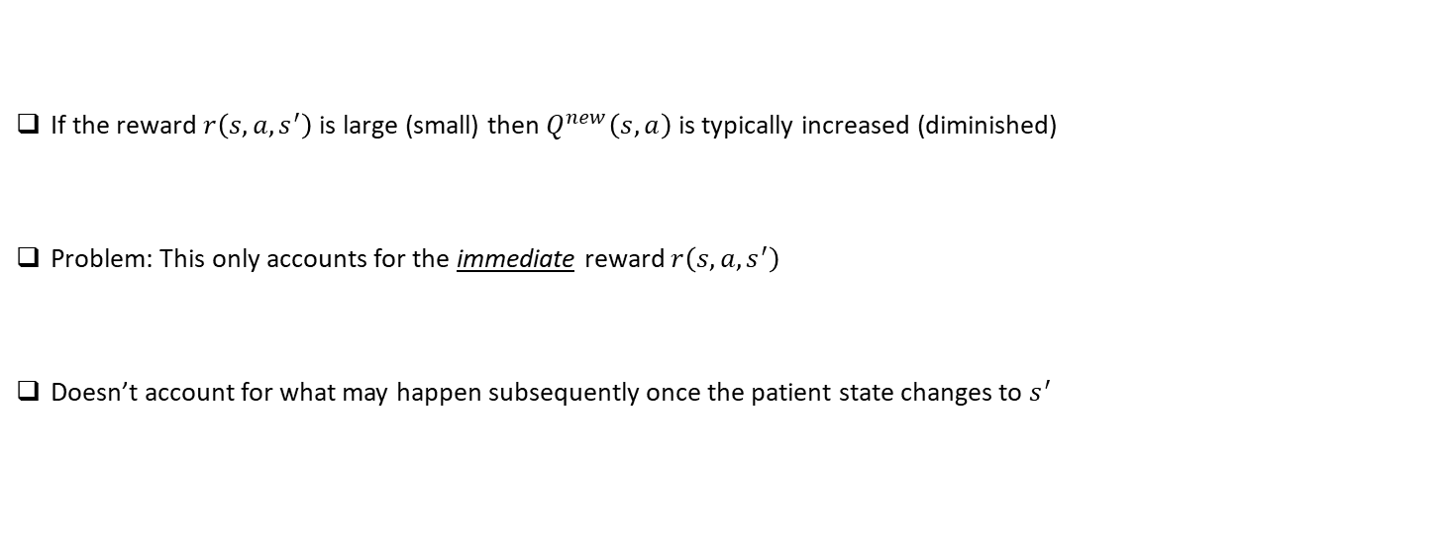
Simple, Intuitive Solution
$Q^{new}\left(s,a\right)←Q^{old}\left(s,a\right)+α⋅\left[ r\left(s,a,s^{′}\right)−Q^{old}\left(s,a\right)\right] ,$ with $α∈(0,1)$
If the reward $r\left(s,a,s^{′}\right)$ is large (small) then $Q^{new}\left(s,a\right)$ is typically increased (diminished)
Problem: This only accounts for the immediate reward $r\left(s,a,s^{′}\right)$
Doesn’t account for what may happen subsequently once the patient state changes to $s^{′}$

Slide 30
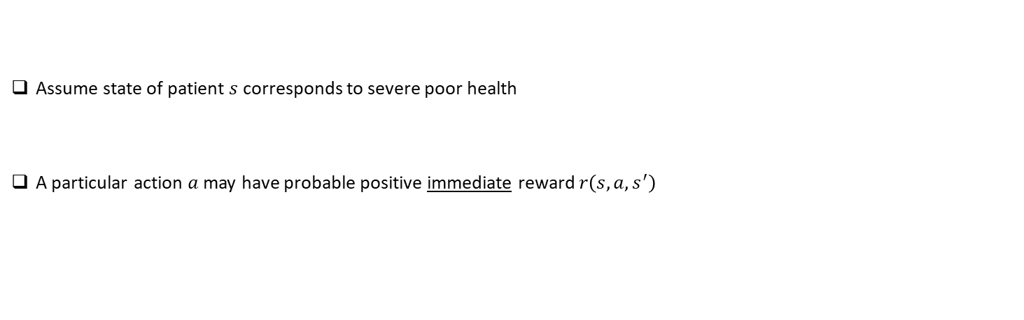
Example: Problem With Myopic Policy
$Q^{new}\left(s,a\right)←Q^{old}\left(s,a\right)+α⋅\left[ r\left(s,a,s^{′}\right)−Q^{old}\left(s,a\right)\right] ,$ with $α∈(0,1)$
Assume state of patient $s$ corresponds to severe poor health
A particular action $a$ may have probable positive immediate reward $r\left(s,a,s^{′}\right)$

Slide 31
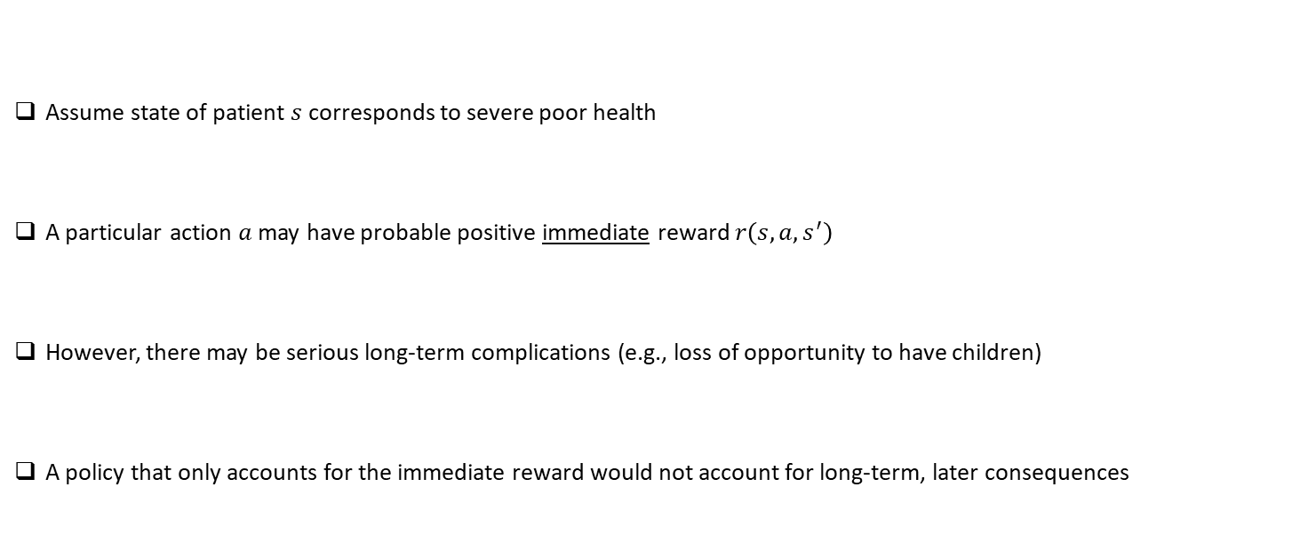
Example: Problem With Myopic Policy
$Q^{new}\left(s,a\right)←Q^{old}\left(s,a\right)+α⋅\left[ r\left(s,a,s^{′}\right)−Q^{old}\left(s,a\right)\right] ,$ with $α∈(0,1)$
Assume state of patient $s$ corresponds to severe poor health
A particular action $a$ may have probable positive immediate reward $r\left(s,a,s^{′}\right)$
However, there may be serious long-term complications (e.g., loss of opportunity to have children)
A policy that only accounts for the immediate reward would not account for long-term, later consequences

Slide 32
Extension
Recall our simple solution
$Q^{new}\left(s,a\right)←Q^{old}\left(s,a\right)+α⋅\left[ r\left(s,a,s^{′}\right)−Q^{old}\left(s,a\right)\right] ,$ with $α∈(0,1)$

Slide 33
Extension
Recall our simple solution
Consider the extension
$Q^{new}\left(s,a\right)←Q^{old}\left(s,a\right)+α⋅\left[ r\left(s,a,s^{′}\right)−Q^{old}\left(s,a\right)\right] ,$ with $α∈(0,1)$
$$Q^{new}\left(s,a\right)←Q^{old}\left(s,a\right)+α⋅[ r\left(s,a,s^{′}\right)+γ⋅\max_{a^{′}} Q^{old}\left(s^{′},a^{′}\right)−Q^{old} \left(s,a\right)]$$

Slide 34
Extension
Recall our simple solution
Consider the extension
$Q^{new}\left(s,a\right)←Q^{old}\left(s,a\right)+α⋅\left[ r\left(s,a,s^{′}\right)−Q^{old}\left(s,a\right)\right] ,$ with $α∈(0,1)$
$$Q^{new}\left(s,a\right)←Q^{old}\left(s,a\right)+α⋅[ r\left(s,a,s^{′}\right)+γ⋅\max_{a^{′}} Q^{old}\left(s^{′},a^{′}\right)−Q^{old} \left(s,a\right)]$$

Slide 35
Extension
Recall our simple solution
Consider the extension
$Q^{new}\left(s,a\right)←Q^{old}\left(s,a\right)+α⋅\left[ r\left(s,a,s^{′}\right)−Q^{old}\left(s,a\right)\right] ,$ with $α∈(0,1)$
Immediate
Reward
Discount Factor Between 0 and 1
$$Q^{new}\left(s,a\right)←Q^{old}\left(s,a\right)+α⋅[ r\left(s,a,s^{′}\right)+γ⋅\max_{a^{′}} Q^{old}\left(s^{′},a^{′}\right)−Q^{old} \left(s,a\right)]$$
Expected Future Rewards
Based on Optimal
Policy

Slide 36
Extension
Recall our simple solution
Consider the extension
$Q^{new}\left(s,a\right)←Q^{old}\left(s,a\right)+α⋅\left[ r\left(s,a,s^{′}\right)−Q^{old}\left(s,a\right)\right] ,$ with $α∈(0,1)$
$$Q^{new}\left(s,a\right)←Q^{old}\left(s,a\right)+α⋅[ r\left(s,a,s^{′}\right)+γ⋅\max_{a^{′}} Q^{old}\left(s^{′},a^{′}\right)−Q^{old} \left(s,a\right)]$$
Non-Myopic Temporal Difference (TD)

Slide 37
Learning Rule
Based on simple logic and intuition, we have derived
$$Q^{new}\left(s,a\right)←Q^{old}\left(s,a\right)+α⋅[ r\left(s,a,s^{′}\right)+γ⋅\max_{a^{′}} Q^{old}\left(s^{′},a^{′}\right)−Q^{old} \left(s,a\right)]$$

Slide 38
Learning Rule
Based on simple logic and intuition, we have derived
May be expressed equivalently as
$$Q^{new}\left(s,a\right)←Q^{old}\left(s,a\right)+α⋅[ r\left(s,a,s^{′}\right)+γ⋅\max_{a^{′}} Q^{old}\left(s^{′},a^{′}\right)−Q^{old} \left(s,a\right)]$$
$$Q^{new}\left(s,a\right)←{\left(1−α\right)⋅Q}^{old}\left(s,a\right)+α⋅[ r\left(s,a,s^{′}\right)+γ⋅\max_{a^{′}} Q^{old}\left(s^{′},a^{′}\right) ]$$

Slide 39
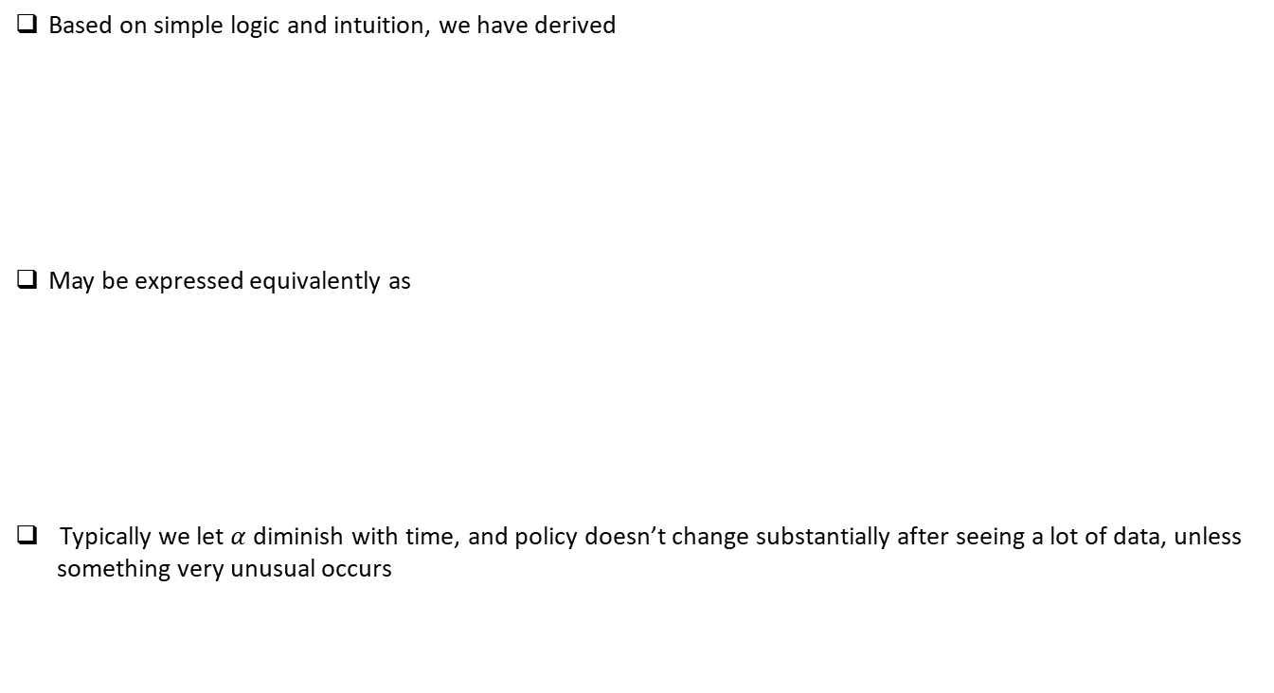
Learning Rule
Based on simple logic and intuition, we have derived
May be expressed equivalently as
Typically we let $α$ diminish with time, and policy doesn’t change substantially after seeing a lot of data, unless
something very unusual occurs
$$Q^{new}\left(s,a\right)←Q^{old}\left(s,a\right)+α⋅[ r\left(s,a,s^{′}\right)+γ⋅\max_{a^{′}} Q^{old}\left(s^{′},a^{′}\right)−Q^{old} \left(s,a\right)]$$
$$Q^{new}\left(s,a\right)←{\left(1−α\right)⋅Q}^{old}\left(s,a\right)+α⋅[ r\left(s,a,s^{′}\right)+γ⋅\max_{a^{′}} Q^{old}\left(s^{′},a^{′}\right) ]$$

Slide 40
Q Learning
$$Q^{new}\left(s,a\right)←{\left(1−α\right)⋅Q}^{old}\left(s,a\right)+α⋅[ r\left(s,a,s^{′}\right)+γ⋅\max_{a^{′}} Q^{old}\left(s^{′},a^{′}\right) ]$$
We have derived an algorithm for a system/MD to learn based on experience
This is actually a widely employed method for reinforcement learning, called Q Learning

Slide 41
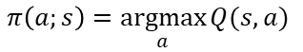
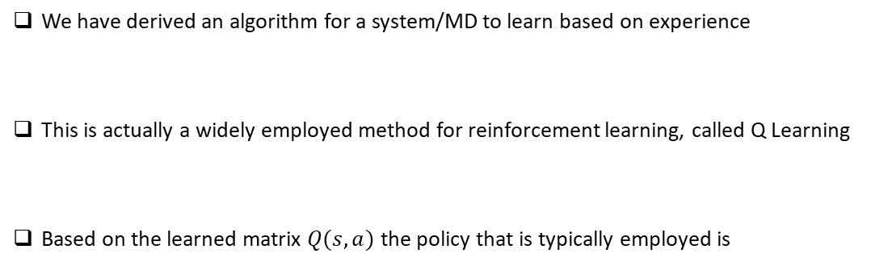
Q Learning
$$Q^{new}\left(s,a\right)←{\left(1−α\right)⋅Q}^{old}\left(s,a\right)+α⋅[ r\left(s,a,s^{′}\right)+γ⋅\max_{a^{′}} Q^{old}\left(s^{′},a^{′}\right) ]$$
We have derived an algorithm for a system/MD to learn based on experience
This is actually a widely employed method for reinforcement learning, called Q Learning
Based on the learned matrix $Q(s,a)$ the policy that is typically employed is
$$π\left(a;s\right)=\underset{a}{argmax}{Q(s,a)}$$

Slide 42
Q Learning
$$Q^{new}\left(s_{t},a_{t}\right)←\left(1−α\right)⋅Q^{old}\left(s_{t},a_{t}\right)+α⋅[r_{t}+γ⋅\max_{a}{Q^{old}(s_{t+1},a)]}$$

Slide 43
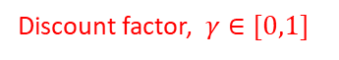
Q Learning
Discount factor, $γ∈[0,1]$
$$Q^{new}\left(s_{t},a_{t}\right)←\left(1−α\right)⋅Q^{old}\left(s_{t},a_{t}\right)+α⋅[r_{t}+γ⋅\max_{a}{Q^{old}(s_{t+1},a)]}$$

Slide 44
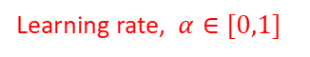
Q Learning
$$Q^{new}\left(s_{t},a_{t}\right)←\left(1−α\right)⋅Q^{old}\left(s_{t},a_{t}\right)+α⋅[r_{t}+γ⋅\max_{a}{Q^{old}(s_{t+1},a)]}$$
Learning rate, $α∈[0,1]$

Slide 45
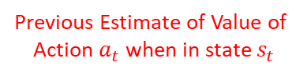
Q Learning
$$Q^{new}\left(s_{t},a_{t}\right)←\left(1−α\right)⋅Q^{old}\left(s_{t},a_{t}\right)+α⋅[r_{t}+γ⋅\max_{a}{Q^{old}(s_{t+1},a)]}$$
Previous Estimate of Value of
Action $a_{t}$ when in state $s_{t}$

Slide 46
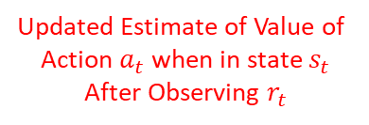
Q Learning
$$Q^{new}\left(s_{t},a_{t}\right)←\left(1−α\right)⋅Q^{old}\left(s_{t},a_{t}\right)+α⋅[r_{t}+γ⋅\max_{a}{Q^{old}(s_{t+1},a)]}$$
Updated Estimate of Value of
Action $a_{t}$ when in state $s_{t}$
After Observing $r_{t}$

Slide 47

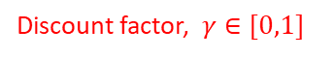


Q Learning
Learning rate, $α∈[0,1]$
Discount factor, $γ∈[0,1]$
$$Q^{new}\left(s_{t},a_{t}\right)←\left(1−α\right)⋅Q^{old}\left(s_{t},a_{t}\right)+α⋅[r_{t}+γ⋅\max_{a}{Q^{old}(s_{t+1},a)]}$$
Previous Estimate of Value of
Action $a_{t}$ when in state $s_{t}$
Updated Estimate of Value of
Action $a_{t}$ when in state $s_{t}$
After Observing $r_{t}$

Slide 48
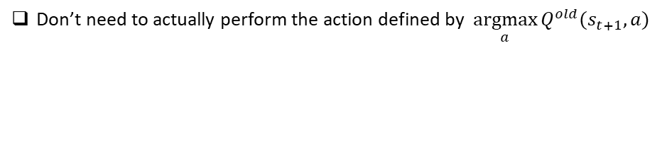
Q Learning
$$Q^{new}\left(s_{t},a_{t}\right)←\left(1−α\right)⋅Q^{old}\left(s_{t},a_{t}\right)+α⋅[r_{t}+γ⋅\max_{a}{Q^{old}(s_{t+1},a)]}$$
Don’t need to actually perform the action defined by $\underset{a}{argmax}{Q^{old}(s_{t+1},a)}$

Slide 49
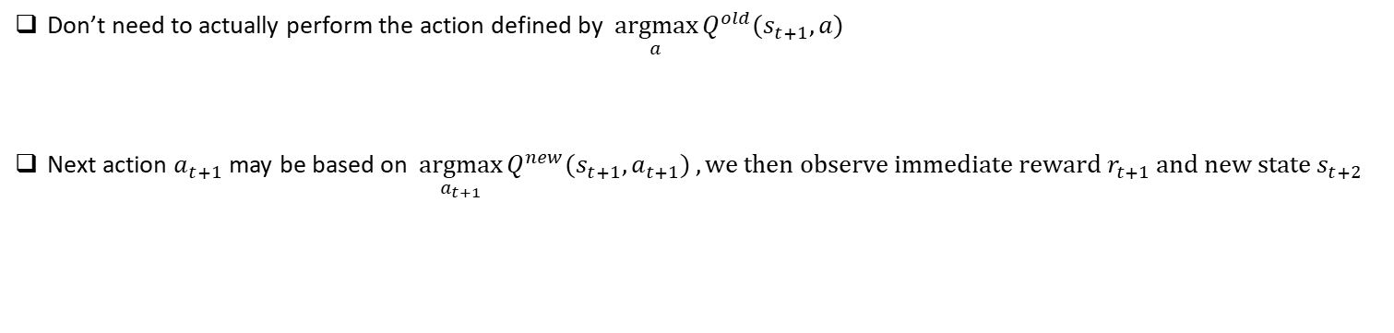
Q Learning
$$Q^{new}\left(s_{t},a_{t}\right)←\left(1−α\right)⋅Q^{old}\left(s_{t},a_{t}\right)+α⋅[r_{t}+γ⋅\max_{a}{Q^{old}(s_{t+1},a)]}$$
Don’t need to actually perform the action defined by $\underset{a}{argmax}{Q^{old}(s_{t+1},a)}$
Next action $a_{t+1}$may be based on $\underset{a_{t+1}}{argmax}{Q^{new}(s_{t+1},a_{t+1})}, we then observe immediate reward r_{t+1} and new state s_{t+2 }$
$${… s}_{t}{ a}_{t}{ r}_{t}{ s}_{t+1}{{ a}_{t+1}{ r}_{t+1} s}_{t+2}…$$

Slide 50
Q Learning
$$Q^{new}\left(s_{t},a_{t}\right)←\left(1−α\right)⋅Q^{old}\left(s_{t},a_{t}\right)+α⋅[r_{t}+γ⋅\max_{a}{Q^{old}(s_{t+1},a)]}$$
Don’t need to actually perform the action defined by $\underset{a}{argmax}{Q^{old}(s_{t+1},a)}$
Next action $a_{t+1}$may be based on $\underset{a_{t+1}}{argmax}{Q^{new}(s_{t+1},a_{t+1})}, we then observe immediate reward r_{t+1} and new state s_{t+2 }$
$${… s}_{t}{ a}_{t}{ r}_{t}{ s}_{t+1}{{ a}_{t+1}{ r}_{t+1} s}_{t+2}…$$
Sequentially and continually update the Q function $Q^{new}\left(s_{t},a_{t}\right)$, which is an $n×m$ matrix

Slide 51
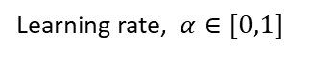
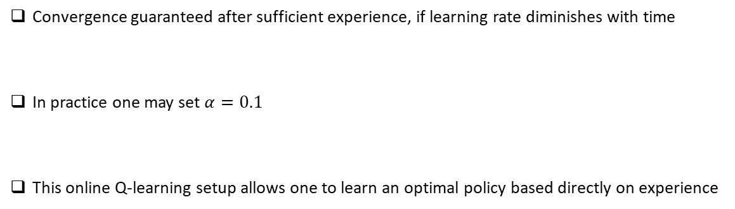
Learning Rate
$$Q^{new}\left(s_{t},a_{t}\right)←\left(1−α\right)⋅Q^{old}\left(s_{t},a_{t}\right)+α⋅[r_{t}+γ⋅\max_{a}{Q^{old}(s_{t+1},a)]}$$
Learning rate, $α∈[0,1]$
Convergence guaranteed after sufficient experience, if learning rate diminishes with time
In practice one may set $α=0.1$
This online Q-learning setup allows one to learn an optimal policy based directly on experience

Slide 52
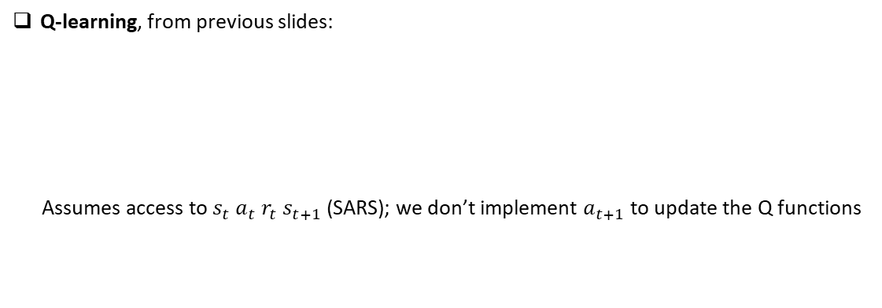
Q Learning vs. SARSA
Q-learning, from previous slides:
Assumes access to $s_{t} a_{t} r_{t} s_{t+1}$ (SARS); we don’t implement $a_{t+1}$ to update the Q functions
$$Q^{new}\left(s_{t},a_{t}\right)←\left(1−α\right)⋅Q^{old}\left(s_{t},a_{t}\right)+α⋅[r_{t}+γ⋅\max_{a}{Q^{old}(s_{t+1},a)]}$$

Slide 53
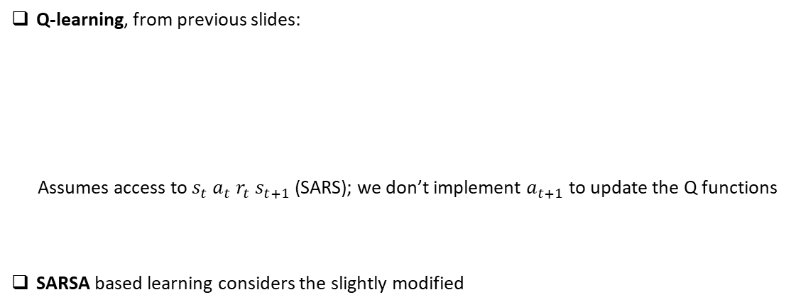
Q Learning vs. SARSA
Q-learning, from previous slides:
Assumes access to $s_{t} a_{t} r_{t} s_{t+1}$ (SARS); we don’t implement $a_{t+1}$ to update the Q functions
SARSA based learning considers the slightly modified
$$Q^{new}\left(s_{t},a_{t}\right)←\left(1−α\right)⋅Q^{old}\left(s_{t},a_{t}\right)+α⋅[r_{t}+γ⋅\max_{a}{Q^{old}(s_{t+1},a)]}$$
$$Q^{new}\left(s_{t},a_{t}\right)←\left(1−α\right)⋅Q^{old}\left(s_{t},a_{t}\right)+α⋅[r_{t}+γ⋅Q^{old}\left(s_{t+1},a_{t+1}\right)]$$
Assumes access to $s_{t} a_{t} r_{t} s_{t+1} a_{t+1}$ (SARSA); $a_{t+1}$ may be specified by some chosen mechanism

Slide 54
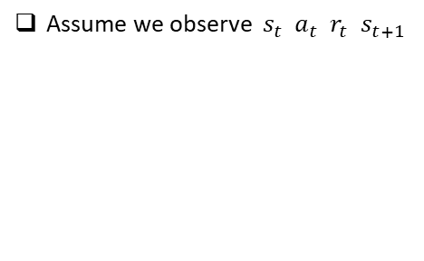

$ε$-Greedy: Exploration and Exploitation
$$Q^{new}\left(s_{t},a_{t}\right)←\left(1−α\right)⋅Q^{old}\left(s_{t},a_{t}\right)+α⋅[r_{t}+γ⋅Q^{old}\left(s_{t+1},a_{t+1}\right)]$$
Assume we observe $s_{t} a_{t} r_{t} s_{t+1}$

Slide 55
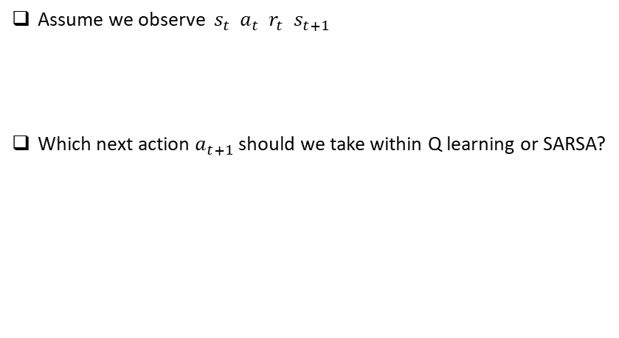
$ε$-Greedy: Exploration and Exploitation
$$Q^{new}\left(s_{t},a_{t}\right)←\left(1−α\right)⋅Q^{old}\left(s_{t},a_{t}\right)+α⋅[r_{t}+γ⋅Q^{old}\left(s_{t+1},a_{t+1}\right)]$$
Assume we observe $s_{t} a_{t} r_{t} s_{t+1}$
Which next action $a_{t+1}$ should we take within Q learning or SARSA?

Slide 56
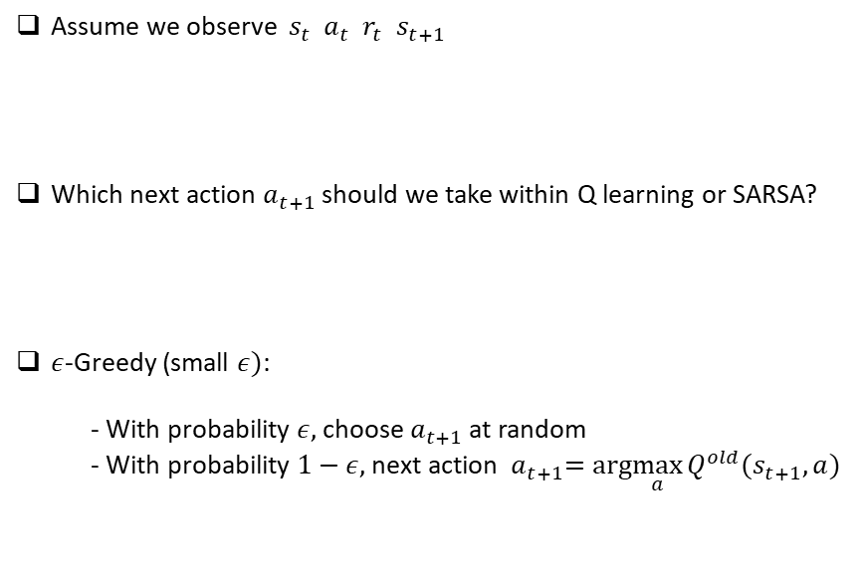
$ε$-Greedy: Exploration and Exploitation
$$Q^{new}\left(s_{t},a_{t}\right)←\left(1−α\right)⋅Q^{old}\left(s_{t},a_{t}\right)+α⋅[r_{t}+γ⋅Q^{old}\left(s_{t+1},a_{t+1}\right)]$$
Assume we observe $s_{t} a_{t} r_{t} s_{t+1}$
Which next action $a_{t+1}$ should we take within Q learning or SARSA?
$ε$-Greedy (small $ε)$:
- With probability $ε,$choose $a_{t+1}$ at random
- With probability $1−ε,$ next action ${ a}_{t+1}=arg\max_{a}{Q^{old}(s_{t+1},a)}$

Slide 57
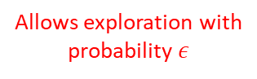
$ε$-Greedy: Exploration and Exploitation
$$Q^{new}\left(s_{t},a_{t}\right)←\left(1−α\right)⋅Q^{old}\left(s_{t},a_{t}\right)+α⋅[r_{t}+γ⋅Q^{old}\left(s_{t+1},a_{t+1}\right)]$$
Assume we observe $s_{t} a_{t} r_{t} s_{t+1}$
Which next action $a_{t+1}$ should we take within Q learning or SARSA?
$ε$-Greedy (small $ε)$:
- With probability $ε,$choose $a_{t+1}$ at random
- With probability $1−ε,$ next action ${ a}_{t+1}=arg\max_{a}{Q^{old}(s_{t+1},a)}$
Allows exploration with
probability $ε$

Slide 58
Reinforcement Learning
Lecture 2
Lawrence Carin
Duke University

Slide 59
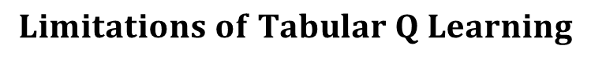
$$Limitations of Tabular Q Learning$$
$$Q^{new}\left(s_{t},a_{t}\right)←\left(1−α\right)⋅Q^{old}\left(s_{t},a_{t}\right)+α⋅[r_{t}+γ⋅\max_{a}{Q^{old}(s_{t+1},a)]}$$
Simple update rule, but …..
The Q function is stored as a table/matrix, which is impractical when considering
a large number of states and actions
No real capacity to generalize across sequence types, because the tabular Q function
does not have a functional form

Slide 60

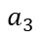
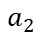
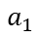
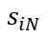
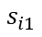
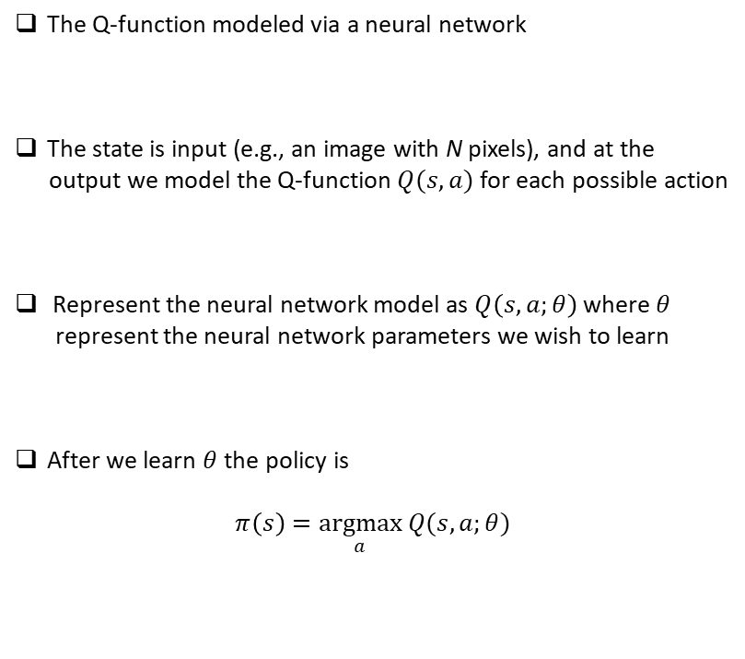
$$Represent Q Function as a Neural Network$$
$$a_{1}$$
$$a_{2}$$
$$a_{3}$$
The Q-function modeled via a neural network
The state is input (e.g., an image with N pixels), and at the
output we model the Q-function $Q(s,a)$ for each possible action
Represent the neural network model as $Q\left(s,a;θ\right)$ where $θ$
represent the neural network parameters we wish to learn
After we learn $θ$ the policy is
$$π\left(s\right)=\underset{a}{argmax} Q(s,a;θ)$$
$$s_{i1}$$
$$s_{iN}$$

Slide 61
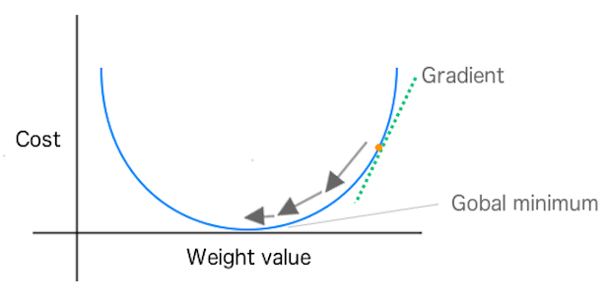
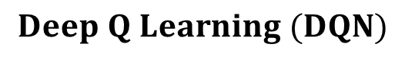
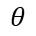



$$Deep Q Learning (DQN)$$
If we update $θ$ like in Q learning, with every new observed $s_{t} a_{t} r_{t} s_{t+1}^{′}$ , at each step we seek to minimize
To move $θ$ such that $U\left(θ;s_{t},a_{t}\right) is made smaller, we update model parameters as$
$$U({θ; s}_{t}, a_{t})=\frac{1}{2}[Q\left(s_{t},a_{t};θ\right)−{[r}_{t}+γ⋅{\underset{}{\max_{a^{′}}⁡Q(s_{t+1}^{′},a^{′};θ^{old})] ]}}^{2}$$
$$U(θ)$$
$$θ$$

Slide 62





$$Gradient Descent$$
If we update $θ$ like in Q learning, with every new observed $s_{t} a_{t} r_{t} s_{t+1}^{′}$ , at each step we seek to minimize
To move $θ$ such that $U\left(θ;s_{t},a_{t}\right) is made smaller, we update model parameters as$
$$U({θ; s}_{t}, a_{t})= \frac{1}{2}[Q\left(s_{t},a_{t};θ\right)−{[r}_{t}+γ⋅{\underset{}{\max_{a^{′}}⁡Q(s_{t+1}^{′},a^{′};θ^{old})] ]}}^{2}$$
$$U(θ)$$
$$θ^{new}←θ^{old}−α⋅∇_{θ}U{\left(θ;s_{t},a_{t}\right)}_{\begin{aligned}{\left.​\right|}_{θ=θ^{old}} \\ \end{aligned}}$$
$$θ$$

Slide 63
$$Gradient Descent$$
If we update $θ$ like in Q learning, with every new observed $s_{t} a_{t} r_{t} s_{t+1}^{′}$ , at each step we seek to minimize
To move $θ$ such that $U\left(θ;s_{t},a_{t}\right) is made smaller, we update model parameters as$
$$U({θ; s}_{t}, a_{t})= \frac{1}{2}[Q\left(s_{t},a_{t};θ\right)−{[r}_{t}+γ⋅{\underset{}{\max_{a^{′}}⁡Q(s_{t+1}^{′},a^{′};θ^{old})] ]}}^{2}$$
$$U(θ)$$
$$θ^{new}←θ^{old}−α⋅∇_{θ}U{\left(θ;s_{t},a_{t}\right)}_{\begin{aligned}{\left.​\right|}_{θ=θ^{old}} \\ \end{aligned}}$$
Multi-dimensional “slope”
$$θ$$

Slide 64


$$Gradient Descent$$
If we update $θ$ like in Q learning, with every new observed $s_{t} a_{t} r_{t} s_{t+1}^{′}$ , at each step we seek to minimize
To move $θ$ such that $U\left(θ;s_{t},a_{t}\right) is made smaller, we update model parameters as$
$$U({θ; s}_{t}, a_{t})= \frac{1}{2}[Q\left(s_{t},a_{t};θ\right)−{[r}_{t}+γ⋅{\underset{}{\max_{a^{′}}⁡Q(s_{t+1}^{′},a^{′};θ^{old})] ]}}^{2}$$
$$θ^{new}←θ^{old}−α⋅∇_{θ}U{\left(θ;s_{t},a_{t}\right)}_{\begin{aligned}{\left.​\right|}_{θ=θ^{old}} \\ \end{aligned}}$$
$$θ^{new}←θ^{old}−α⋅\left[Q\left(s_{t},a_{t};θ^{old}\right)−r_{t}−γ⋅\max_{a^{′}} Q\left(s_{t+1}^{′},a^{′};θ^{old}\right)\right]∇_{θ}Q{\left(s_{t},a_{t};θ\right)}_{{\left.​\right|}_{θ=θ^{old}}}$$

Slide 65

$$Gradient Descent$$
$$θ^{new}←θ^{old}+α⋅\left[r_{t}+γ⋅\max_{a^{′}} Q\left(s_{t+1}^{′},a^{′};θ^{old}\right)−Q(s_{t},a_{t};θ^{old} )\right]∇_{θ}Q{\left(s_{t},a_{t};θ\right)}_{{\left.​\right|}_{θ=θ^{old}}}$$
Looks a lot like the prior Q learning

Slide 66

$$Gradient Descent$$
$$θ^{new}←θ^{old}+α⋅\left[r_{t}+γ⋅\max_{a^{′}} Q\left(s_{t+1}^{′},a^{′};θ^{old}\right)−Q(s_{t},a_{t};θ^{old} )\right]∇_{θ}Q{\left(s_{t},a_{t};θ\right)}_{{\left.​\right|}_{θ=θ^{old}}}$$
Modification to account for
neural network parameters $θ$

Slide 67

$$Gradient Descent$$
$$θ^{new}←θ^{old}+α⋅\left[r_{t}+γ⋅\max_{a^{′}} Q\left(s_{t+1}^{′},a^{′};θ^{old}\right)−Q(s_{t},a_{t};θ^{old} )\right]∇_{θ}Q{\left(s_{t},a_{t};θ\right)}_{{\left.​\right|}_{θ=θ^{old}}}$$
Looks a lot like the prior Q learning
Modification to account for
neural network parameters $θ$
One may show rigorously that this is directly related to the prior sequential Q learning
Details not very difficult (first-order Taylor series expansion), but beyond the scope of our discussion (see Appendix)

Slide 68


$$Revisit What Deep Q Network Seeks to Learn$$
Seek parameters $θ$ that minimize prediction error
$$U({θ; s}_{t}, a_{t})=\frac{1}{2}[Q\left(s_{t},a_{t};θ\right)−{[r}_{t}+γ⋅{\underset{}{\max_{a^{′}}⁡Q(s_{t+1}^{′},a^{′};θ^{old})] ]}}^{2}$$

Slide 69



$$Revisit What Deep Q Network Seeks to Learn$$
Seek parameters $θ$ that minimize prediction error
$$U({θ; s}_{t}, a_{t})=\frac{1}{2}[Q\left(s_{t},a_{t};θ\right)−{[r}_{t}+γ⋅{\underset{}{\max_{a^{′}}⁡Q(s_{t+1}^{′},a^{′};θ^{old})] ]}}^{2}$$
$$a_{1}$$
$$a_{2}$$
$$a_{3}$$
Predictive model for value
of state-action pair $(s_{t},a_{t})$
$$s_{i1}$$
$$s_{iN}$$

Slide 70
$$Revisit What Deep Q Network Seeks to Learn$$
Seek parameters $θ$ that minimize prediction error
Discounted future rewards
$$a_{1}$$
$$a_{2}$$
$$a_{3}$$
Next immediate reward
Predictive model for value
of state-action pair $(s_{t},a_{t})$
$$s_{i1}$$
$$s_{iN}$$

Slide 71
$$Revisit What Deep Q Network Seeks to Learn$$
Seek parameters $θ$ that minimize prediction error
Discounted future rewards
$$a_{1}$$
$$a_{2}$$
$$a_{3}$$
Next immediate reward
Predictive model for value
of state-action pair $(s_{t},a_{t})$
Supervised Learning
$$s_{i1}$$
$$s_{iN}$$

Slide 72


$$Power of Deep Q Networks for RL With Images$$
Seek parameters $θ$ that minimize prediction error
Predictive model for value
of state-action pair $(s_{t−1},a_{t−1})$

Slide 73

$$Power of Deep Q Networks for RL With Images$$
Seek parameters $θ$ that minimize prediction error
State $s_{t}$ (an image)

Slide 74

$$Power of Deep Q Networks for RL With Images$$
Seek parameters $θ$ that minimize prediction error
$$Q\left(s_{t},a_{t};θ\right)$$
for each $a_{t}∈A$
State $s_{t}$ (an image)
Predictive model for value
of state-action pair $(s_{t−1},a_{t−1})$

Slide 75
$$Power of Deep Q Networks for RL With Images$$
Seek parameters $θ$ that minimize prediction error
$$Q\left(s_{t},a_{t};θ\right)$$
for each $a_{t}∈A$
State $s_{t}$ (an image)
Predictive model for value
of state-action pair $(s_{t−1},a_{t−1})$

Slide 76



Slide 77


$$Atari Games$$

Slide 78


$$Final Thoughts$$
Tabular Q Learning employs the update rule
Deep Q Learning uses a deep neural network with parameters $θ$ to minimize the functional
Reinforcement learning has been studied for decades, and there are many other methods that we have
not considered here, and are worth learning about for those interested
There is also a rich theoretical foundation to RL, and therefore much is known about the fundamentals of
these methods
$$Q^{new}\left(s_{t},a_{t}\right)←\left(1−α\right)⋅Q^{old}\left(s_{t},a_{t}\right)+α⋅[r_{t}+γ⋅Q^{old}\left(s_{t+1},a_{t+1}\right)]$$

Slide 79
Appendix 1
Introduction to Markov Decision Process (MDP)

Slide 80

Markov Decision Process (MDP)
A set of states $S=\left(s_{1},…, s_{n}\right)$
We observe the state of the system/environment/subject

Slide 81

Markov Decision Process (MDP)
A set of states $S=\left(s_{1},…, s_{n}\right)$
We observe the state of the system/environment/subject
A set of actions $A=\left(a_{1}, …, a_{m}\right)$
We may select an action to take, given that the system is in an observed state $s$

Slide 82

Markov Decision Process (MDP)
A set of states $S=\left(s_{1},…, s_{n}\right)$
We observe the state of the system/environment/subject
A set of actions $A=\left(a_{1}, …, a_{m}\right)$
We may select an action to take, given that the system is in an observed state $s$
State-transition probabilities $P(s,a,s^{′})$
Defines the probability of transitioning $s→s′$ upon taking action $a$ when in state $s$; $\sum_{s^{′}∈S}{P(s,a,s^{′}})=1$

Slide 83

Markov Decision Process (MDP)
A set of states $S=\left(s_{1},…, s_{n}\right)$
We observe the state of the system/environment/subject
A set of actions $A=\left(a_{1}, …, a_{m}\right)$
We may select an action to take, given that the system is in an observed state $s$
State-transition probabilities $P(s,a,s^{′})$
Defines the probability of transitioning $s→s′$ upon taking action $a$ when in state $s′$; $\sum_{s^{′}∈S}{P(s,a,s^{′}})=1$
Set of rewards $r\left(s,a,s′\right)$ reflecting the immediate reward of taking action $a$ in state $s$ and transiting to state $s′$

Slide 84

Markov Decision Process (MDP)
A set of states $S=\left(s_{1},…, s_{n}\right)$
We observe the state of the system/environment/subject
A set of actions $A=\left(a_{1}, …, a_{m}\right)$
We may select an action to take, given that the system is in an observed state $s$
State-transition probabilities $P(s,a,s^{′})$
Defines the probability of transitioning $s→s′$ upon taking action $a$ when in state $s′$; $\sum_{s^{′}∈S}{P(s,a,s^{′}})=1$
Set of rewards $r\left(s,a,s′\right)$ reflecting the immediate reward of taking action $a$ in state $s$ and transiting to state $s′$
Discount factor $γ∈[0,1)$
Reflects the degree to which future rewards are discounted relative to immediate rewards

Slide 85

Markov Decision Process (MDP)
State-action-state transition probabilities
Set of states
$$S, A, P, R, γ$$
Discount factor
Set of actions
Rewards

Slide 86

Policy
A policy $π$ specifies which action $a∈A$ is taken when in state $s∈S$
The policy may be stochastic, with $π(a;s)$ reflecting the probability of action $a$ when in state $s$; $\sum_{i=1}^{m}{π\left(a_{i};s\right)=1}$

Slide 87

Policy
A policy $π$ specifies which action $a∈A$ is taken when in state $s∈S$
The policy may be stochastic, with $π(a;s)$ reflecting the probability of action $a$ when in state $s$; $\sum_{i=1}^{m}{π\left(a_{i};s\right)=1}$
Consider the sequence ($s_{0},a_{0},r_{0},s_{1},a_{1},r_{1}, …, s_{N−1},a_{N−1},r_{N−1},s_{N},a_{N},r_{N}$)
- The total reward for this sequence is $r_{0}+γr_{1}+γ^{2}r_{2}+…+γ^{N}r_{N}$
- This total reward is a random variable, because the sequence of states visited is random
We wish to learn the policy $π$to maximize the expected reward of the “agent” over a sequence of
states, actions and rewards

Slide 88

Expected (Average) Reward of a Policy
The state-action value function $Q^{π}(s,a)$ of any policy $π$ indicates the expected (average) discounted
total reward when taking action $a$ in state $s$ and following the optimal policy thereafter
$$Q^{π}\left(s,a\right)=E_{a_{t}∼π;s_{t}∼P}\left( \sum_{t=0}^{∞}{γ^{t}}r_{t} | { s}_{0}=s,a_{0}=a\right)$$
We may re-express $Q^{π}(s,a)$ as
$$Q^{π}\left(s,a\right)=R\left(s,a\right)+γ\sum_{s^{′}∈S}{P\left(s,a,s^{′}\right) \max_{a^{′}}{ Q}^{π}\left(s^{′},a′\right)}$$
Immediate expected reward $R\left(s,a\right)=\sum_{s^{′}}{P\left(s,a,s^{′}\right)r(s,a,s^{′})}$

Slide 89



Deterministic Policy
Assumed the policy selects the single most rewarding action when in state $s$
Bellman’s equation
Suggests an iterative solution to learn the optimal deterministic policy
$$π\left(s\right)=\arg{\max_{a∈A}{Q^{π}(s,a)}}$$
$$Q^{π}\left(s,a\right)=R\left(s,a\right)+γ\sum_{s^{′}∈S}{P\left(s,a,s^{′}\right)\max_{a^{′}∈A}{Q^{π}(s^{′},a^{′})}}$$

Slide 90


Policy Iteration
Initialize the Q functions with $Q_{0}\left(s,a\right)=R(s,a)$
Iterate as
May be shown that for a large $number of steps$ this iterative solution converges to $Q^{π}\left(s,a\right)$ for the
optimal policy $π(a;s)$
$$Q^{new}\left(s,a\right)←R\left(s,a\right)+γ\sum_{s^{′}∈S}{P\left(s,a,s^{′}\right)\max_{a^{′}∈A}{Q^{old} (s^{′},a^{′})}}$$

Slide 91


Practical Limitations of MDP Policy Learning
$$Q^{new}\left(s,a\right)←R\left(s,a\right)+γ\sum_{s^{′}∈S}{P\left(s,a,s^{′}\right)\max_{a^{′}∈A}{Q^{old} (s^{′},a^{′})}}$$
Assumes we have access to a model of the environment, given by $P\left(s,a,s^{′}\right)$
Typically we do not have these model parameters
Possible strategy: Estimate $P\left(s,a,s^{′}\right)$ based on experience with environment
Challenge: May require a lot of such experience to get good estimates

Slide 92
Appendix 2
Alternative Derivation of Q Learning

Slide 93
Learn the Policy as we Experience Environment
$$Q^{new}\left(s,a\right)←R\left(s,a\right)+γ\sum_{s^{′}∈S}{P\left(s,a,s^{′}\right)\max_{a^{′}∈A}{Q^{old} (s^{′},a^{′})}}$$

Slide 94


Learn the Policy as we Experience Environment
$$Q^{new}\left(s,a\right)←R\left(s,a\right)+γ\sum_{s^{′}∈S}{P\left(s,a,s^{′}\right)\max_{a^{′}∈A}{Q^{old} (s^{′},a^{′})}}$$
Based on the definition of $R\left(s,a\right),$ this is equivalent to
$$Q^{new}\left(s,a\right)←\sum_{s^{′}∈S}{P\left(s,a,s^{′}\right)[r\left(s,a,s^{′}\right)+γ \max_{a^{′}∈A}{Q^{old} (s^{′},a^{′})]}}$$

Slide 95

Learn the Policy as we Experience Environment
$$Q^{new}\left(s,a\right)←R\left(s,a\right)+γ\sum_{s^{′}∈S}{P\left(s,a,s^{′}\right)\max_{a^{′}∈A}{Q^{old} (s^{′},a^{′})}}$$
Based on the definition of $R(s,a)$ this is equivalent to
By the definition of probability, as $K→∞,$ this is equivalent to
$$Q^{new}\left(s,a\right)←\sum_{s^{′}∈S}{P\left(s,a,s^{′}\right)[r\left(s,a,s^{′}\right)+γ \max_{a^{′}∈A}{Q^{old} (s^{′},a^{′})]}}$$
$$Q^{new}\left(s,a\right)←\frac{1}{T}\sum_{t=1}^{T}{ [ r\left(s,a,s_{t}^{′}\right)+γ \underset{}{\max_{a^{′}} Q^{old}\left(s_{t}^{′},a^{′}\right)] , with each s_{t}^{′}∼P(s,a,s^{′})}}$$

Slide 96

Learning from Experience
$$Q^{new}\left(s,a\right)←\frac{1}{T}\sum_{t=1}^{T}{ [ r\left(s,a,s_{t}^{′}\right)+γ \underset{}{\max_{a^{′}} Q^{old}\left(s_{t}^{′},a^{′}\right)] , with each s_{t}^{′}∼P(s,a,s^{′})}}$$
We don’t know the underlying probability distribution $P(s,a,s^{′})$
But we can sample from it, from experience; don’t need to know or estimate $P\left(s,a,s^{′}\right)$
When in state $s$, try an action $a∈A$, and see what happens, i.e., see what reward $r$ is manifested
Model learns to value, or reinforce, actions in a given state that are expected to be valuable

Slide 97
Naïve Q Learning
$$Q^{new}\left(s,a\right)←\frac{1}{T}\sum_{t=1}^{T}{ [ r\left(s,a,s_{t}^{′}\right)+γ \underset{}{\max_{a^{′}} Q^{old}\left(s_{t}^{′},a^{′}\right)] , with each s_{t}^{′}∼P(s,a,s^{′})}}$$
Suggests an update rule we implement “on the fly”, as we experience the environment
$Q^{new}\left(s,a\right)←Q^{old}\left(s,a\right)+[r_{t}+γ \underset{}{\max_{a^{′}} Q^{old}\left(s_{t}^{′},a^{′}\right)]}$ , $with s_{t}^{′}∼P(s,a,s^{′})$

Slide 98
Naïve Q Learning
$$Q^{new}\left(s,a\right)←\frac{1}{T}\sum_{t=1}^{T}{ [ r\left(s,a,s_{t}^{′}\right)+γ \underset{}{\max_{a^{′}} Q^{old}\left(s_{t}^{′},a^{′}\right)] , with each s_{t}^{′}∼P(s,a,s^{′})}}$$
Suggests an update rule we implement “on the fly”, as we experience the environment
$Q^{new}\left(s,a\right)←Q^{old}\left(s,a\right)+[r_{t}+γ \underset{}{\max_{a^{′}} Q^{old}\left(s_{t}^{′},a^{′}\right)]}$ , $with s_{t}^{′}∼P(s,a,s^{′})$
The 1/T factor doesn’t affect policy (max operation), and therefore we ignore it for simplicity

Slide 99


Q-Learning
The simple/naïve setup is
Introduce a “learning rate” $α∈[0,1]$ and modify the update rule as
This is called Q learning, and it allows one to learn a policy on the life, adaptively, as the environment is experienced
$$Q^{new}\left(s,a\right)←Q^{old}\left(s,a\right)+[r_{t}+γ \underset{}{\max_{a^{′}} Q^{old}\left(s_{t}^{′},a^{′}\right)]}$$
$$Q^{new}\left(s,a\right)←\left(1−α\right)⋅Q^{old}\left(s,a\right)+α⋅[r_{t}+γ \underset{}{\max_{a^{′}} Q^{old}\left(s_{t}^{′},a^{′}\right)]}$$

Slide 100
Appendix 3
Connecting Deep Q Learning to Conventional Q Learning

Slide 101

DQN Parameter Update Equation
Recall that in deep Q learning the update equation of the model parameters is:
After implementing the parameter update, the Q function may be expressed as
$$θ^{new}←θ^{old}+α⋅\left[r_{t}+γ⋅\max_{a^{′}} Q\left(s_{t+1}^{′},a^{′};θ^{old}\right)−Q{(s}_{t},a_{t};θ^{old} )\right]∇_{θ}Q{\left(s_{t},a_{t};θ\right)}_{{\left.​\right|}_{θ=θ^{old}}}$$
${Q(s_{t},a_{t};θ}^{new})=Q(s_{t},a_{t};θ^{old}+α⋅[r_{t}+γ⋅\max_{a^{′}} Q\left(s_{t+1}^{′},a^{′};θ^{old}\right)−Q\left(s_{t},a_{t}{;θ}^{old}\right)]∇_{θ}Q{\left(s_{t},a_{t};θ\right)}_{{\left.​\right|}_{θ=θ^{old}}}$)

Slide 102




Taylor Series Expansion
${Q(s_{t},a_{t};θ}^{new})=Q(s_{t},a_{t};θ^{old}+α⋅[r_{t}+γ⋅\max_{a^{′}} Q\left(s_{t+1}^{′},a^{′};θ^{old}\right)−Q\left(s_{t},a_{t}{;θ}^{old}\right)]∇_{θ}Q{\left(s_{t},a_{t};θ\right)}_{{\left.​\right|}_{θ=θ^{old}}}$)
Define
from which
First-order Taylor-series expansion, for small $Δθ$:
$Δθ=α⋅[r_{t}+γ⋅\max_{a^{′}} Q\left(s_{t+1}^{′},a^{′};θ^{old}\right)−Q\left(s_{t},a_{t}{;θ}^{old}\right)]∇_{θ}Q{\left(s_{t},a_{t};θ\right)}_{{\left.​\right|}_{θ=θ^{old}}}$
${Q(s,a;θ}^{new})=Q(s,a;θ^{old}+Δθ$)
$${Q(s,a;θ}^{old}+Δθ)≈Q\left(s,a;θ^{old}\right)+Δθ^{T}∇_{θ}Q{\left(s,a;θ\right)}_{{\left.​\right|}_{θ=θ^{old}}}$$

Slide 103


Taylor Series Expansion
By the definition of $Δθ$
$${Q(s_{t},a_{t};θ}^{old}+Δθ)≈Q\left(s_{t},a_{t};θ^{old}\right)+α⋅\left[r_{t}+γ⋅\max_{a^{′}} Q\left(s_{t+1}^{′},a^{′};θ^{old}\right)−Q\left(s_{t},a_{t}{;θ}^{old}\right)\right]||∇_{θ}Q{\left(s_{t},a_{t};θ\right)}_{{\left.​\right|}_{θ=θ^{old}}}||_{2}^{2}$$
Define $α^{′}=α⋅||∇_{θ}Q{\left(s_{t},a_{t};θ\right)}_{{\left.​\right|}_{θ=θ^{old}}}||_{2}^{2}$, yielding approximately
${Q(s_{t},a_{t};θ}^{new})←\left(1−α^{′}\right)⋅Q\left(s_{t},a_{t};θ^{old}\right)+α^{′}⋅{[r}_{t}+γ⋅\max_{a^{′}} Q\left(s_{t+1}^{′},a^{′};θ^{old}\right)$]

Slide 104


Connecting DQN to Q Learning
The update rule for the model parameters in deep learning is
$$θ^{new}←θ^{old}+α⋅\left[r_{t}+γ⋅\max_{a^{′}} Q\left(s_{t+1}^{′},a^{′};θ^{old}\right)−Q{(s}_{t},a_{t};θ^{old} )\right]∇_{θ}Q{\left(s_{t},a_{t};θ\right)}_{{\left.​\right|}_{θ=θ^{old}}}$$
When viewed from the perspective of the Q function this yields
${Q(s_{t},a_{t};θ}^{new})←\left(1−α^{′}\right)⋅Q\left(s_{t},a_{t};θ^{old}\right)+α^{′}⋅{[r}_{t}+γ⋅\max_{a^{′}} Q\left(s_{t+1}^{′},a^{′};θ^{old}\right)$]
$$α^{′}=α⋅||∇_{θ}Q{\left(s_{t},a_{t};θ\right)}_{{\left.​\right|}_{θ=θ^{old}}}||_{2}^{2}$$
Hence, the update rule in deep Q learning for the model parameters corresponds exactly to the update rule in conventional Q learning

Slide 105


Connecting DQN to Q Learning
When doing updates in deep Q learning we do NOT actually implement
because now the Q function is not simply a table, as in original Q learning
We implement
meaning we update the functional model $Q\left(s,a;θ\right)$ for the Q function
${Q(s_{t},a_{t};θ}^{new})←\left(1−α^{′}\right)⋅Q\left(s_{t},a_{t};θ^{old}\right)+α^{′}⋅{[r}_{t}+γ⋅\max_{a^{′}} Q\left(s_{t+1}^{′},a^{′};θ^{old}\right)$]
$$θ^{new}←θ^{old}+α⋅\left[r_{t}+γ⋅\max_{a^{′}} Q\left(s_{t+1}^{′},a^{′};θ^{old}\right)−Q{(s}_{t},a_{t};θ^{old} )\right]∇_{θ}Q{\left(s_{t},a_{t};θ\right)}_{{\left.​\right|}_{θ=θ^{old}}}$$

